Slide 1
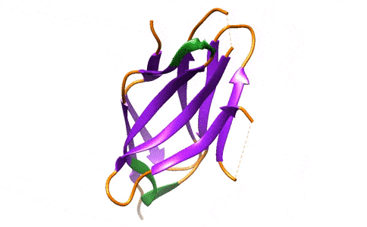
BUILDING PD-1 PROTEIN STRUCTURE FOR DIFFERENT MODELS USING HUMAN PD-1 STRUCTURE AS REFERENCE AND CHECKING THE STRUCTURAL AND SEQUENCE LEVEL SIMILARITIES BETWEEN THEM

Slide 2
Motivation
Cancer is one of the leading causes of deaths in the world. It is a disease in which abnormal cells divide uncontrollably and destroy body tissue.
The main cancer treatment include cancer surgery, radiotherapy, chemotherapy and hormone therapy.
One of the emerging treatments for cancer is immune checkpoint inhibitors which has been approved for cancers like small cell carcinoma of lung, malign melanoma, renal cell carcinoma etc.
Currently approved immune checkpoint inhibitors target the molecules CTLA4, PD1 and PDL1.

Slide 3
Programmed Cell Death Protein 1: Functioning
PD1 is a protein found on T cells (a type of immune cell) that helps keep the body’s immune responses in check.
PD-1 extends from the surface of T-cells, and interacts with two similar ligand proteins, PD-L1 and PD-L2, that are found on the surface of regulatory T cells which control the immune system’s response to self and foreign particles.
Cancers such as melanomas evade the immune system by expressing PD-L1 on their surface, allowing them to trick the immune system by downregulating T-cells.
Immune checkpoint inhibitors target these cancer cells by blocking the interaction of PD-1 and PD-L1, restoring T-cell function.

Slide 4
Programmed Cell Death Protein 1: Properties
Also called CD279
Immunoglobulin superfamily, expressed on T-cells and pro B-cells
Coded by PDCD1 gene which is expressed on chromosome 2 of human
Composed of 288 amino acids
Useful in prevention of autoimmune diseases
Can prevent the immune system from attacking cancer cells
Another reason for studying PD1: Drugs targeting PD1 along with other negative immune checkpoint receptors may augment immune response and/or facilitate HIV eradication.

Slide 5
MODELS
MODEL | COMMON NAME | ACCESSION NUMBER
Macaca mulatta | Rhesus Monkey | NP_001107830.1
Rattus norvegicus | Brown Rat | NP_001100397.1
Bos taurus | Domesticated Cattle | BAX73992.1
Sus scrofa | Pig | NP_001191308
Is the result of the phylogenetic analysis correlating with the RMSD values for the above mentioned models?

Slide 6
SEQUENCE LEVEL ANALYSIS
Tools Used
MegaX
Clustal Omega

Slide 7
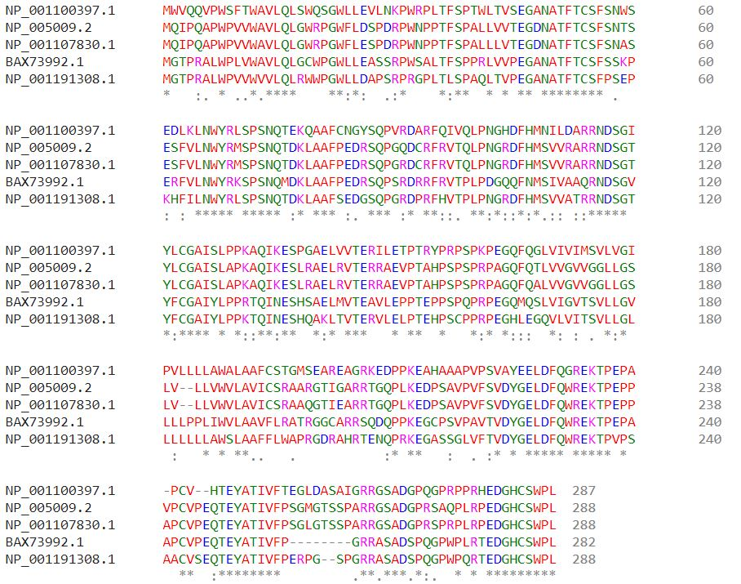
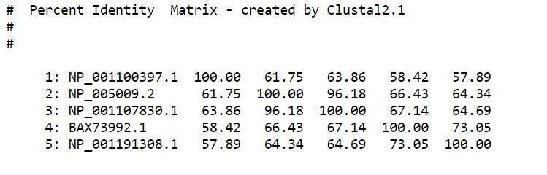
DATA COLLECTION
MULTIPLE SEQUENCE ALIGNMENT
Similarity?
Strong Similarity
(Maximum Parsimony)
Weak Similarity
(Distance methods)
Very weak similarity
(Maximum Likelihood)
PHYLOGENETIC
ANALYSIS
MODEL SELECTION

Slide 8
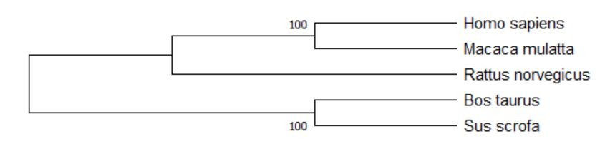
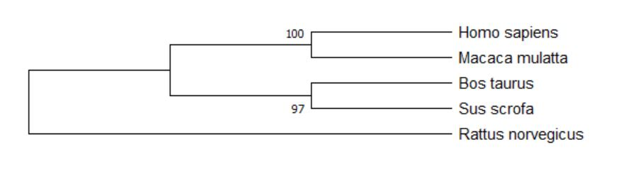
Phylogenetic trees based on distance based models
Neighbor Joining
UPGMA

Slide 9
STRUCTURE LEVEL ANALYSIS
TOOLS USED
NCBI Blast
Swiss Model
Modeller
Chimera
ProCheck

Slide 10
HOMOLOGY MODELING
(Swiss Model)
Known Structures
Target Sequence
Template Selection
Structure Modelling
Structure Evaluation
Homology Model

Slide 11
HOMOLOGY MODELING(Modeller)
DATA COLLECTION
Download the target protein sequence
Run Blast
DATA PREPARATION
Multiple sequence alignment
Keep only the part of the template with which the sequence got aligned
MODELLING
Define the number of models
Select the model which gives the least DOPE value
LOOP REFINEMENT
MODEL EVALUATION
Select the template with the lowest resolution
Download the aligned sequence and the structure of the selected template
Remove the residues
Refine a region of an existing coordinate
Define the number of models
Select the model which gives the least DOPE value
RMSD Score
Ramachandran plot

Slide 12
TEMPLATES
MODELS | PDB ID
 | Swiss Model | Modeller
Macca mulatta | 6K0Y | 6J14
Rattus norvegicus | 3BP5 | 5WT9
Bos taurus | 6K0Y | 5WT9
Sus scrofa | 6K0Y | 5WT9

Slide 13
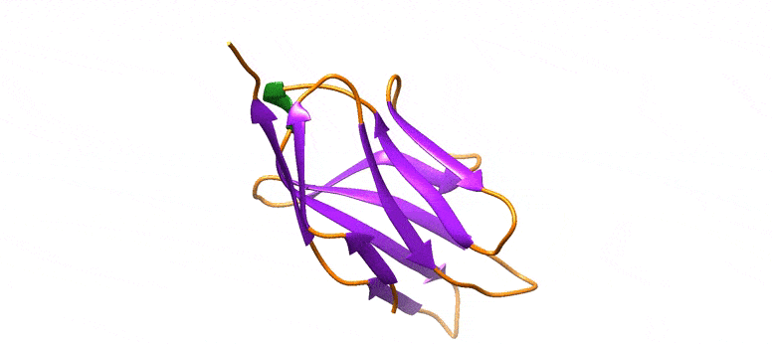
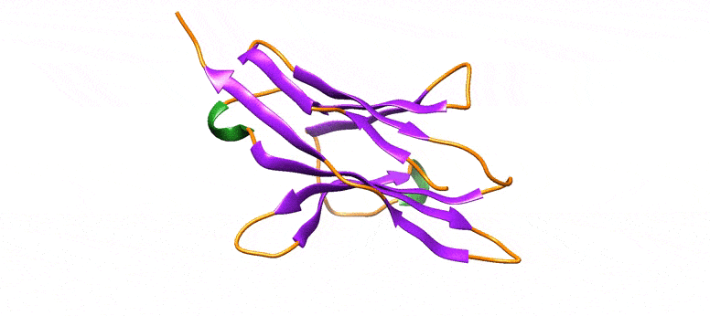
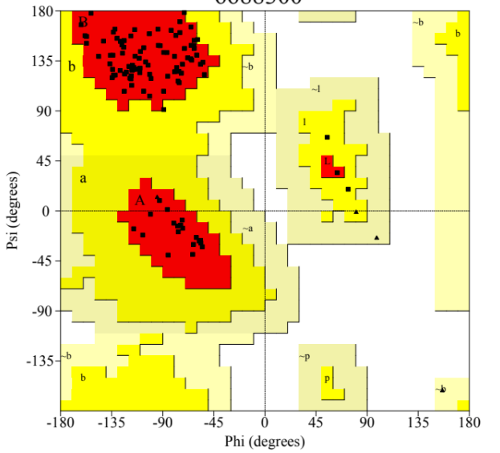
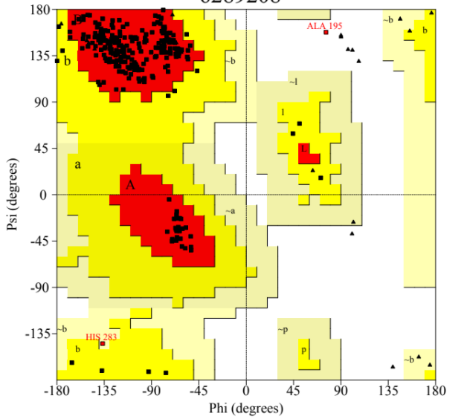
Swiss Model
Modeller
Macaca mulatta
(Rhesus Monkey)
Residues in most favoured regions : 97%
Residues in most favoured regions : 93.1%

Slide 14
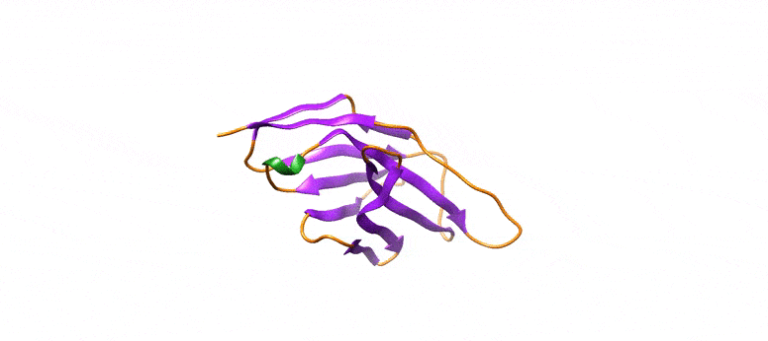
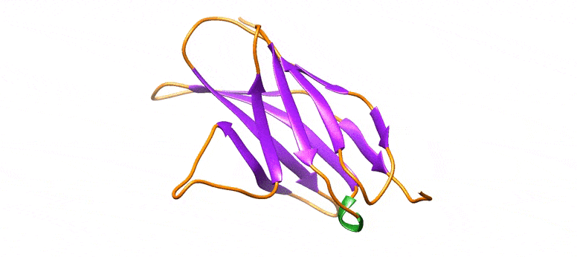
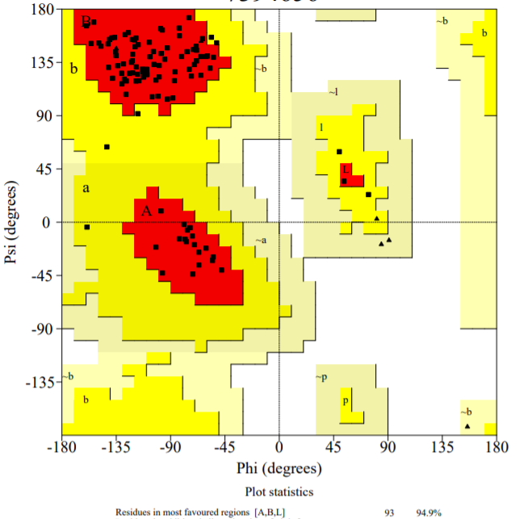
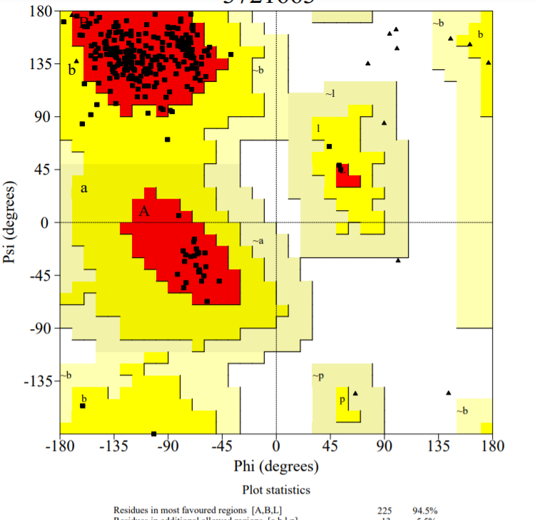
Swiss Model
Modeller
Rattus norvegicus
(BROWN RAT)
Residues in most favoured regions : 94.9%
Residues in most favoured regions : 94.5%

Slide 15
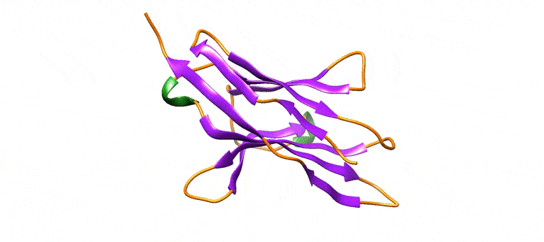
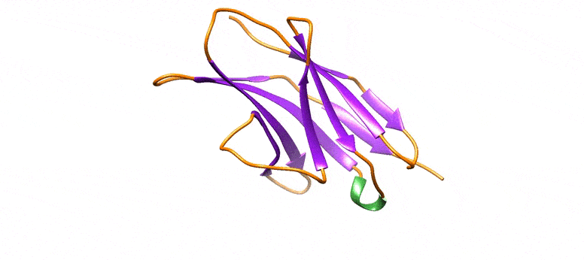

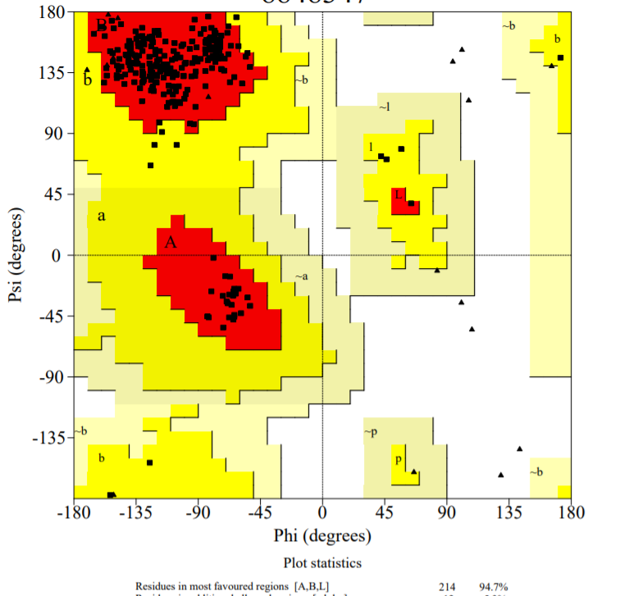
Swiss Model
Modeller
Bos taurus
(Cattle)
Residues in most favoured regions : 97%
Residues in most favoured regions : 94.7%

Slide 16
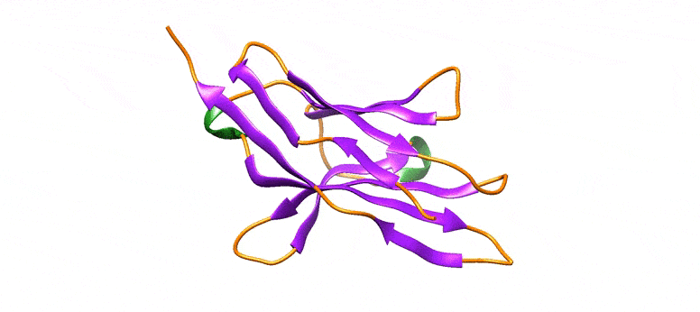
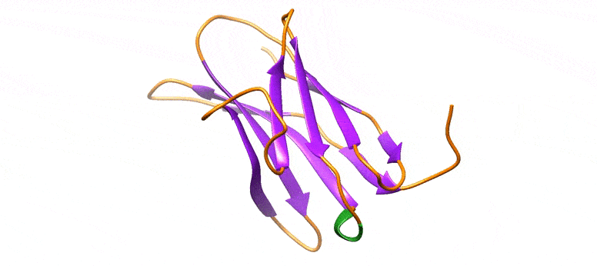
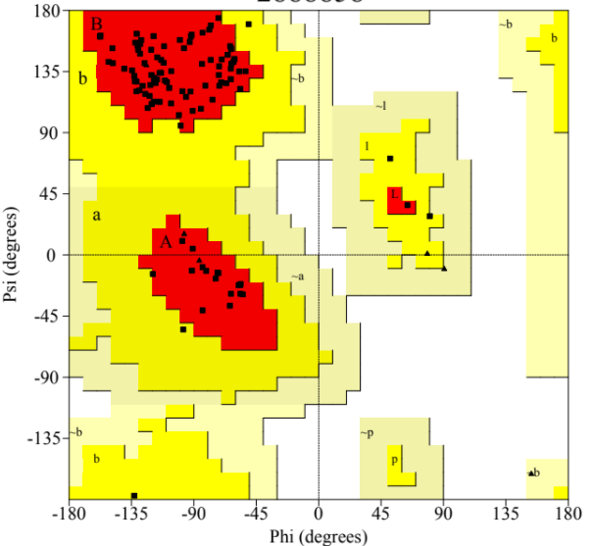
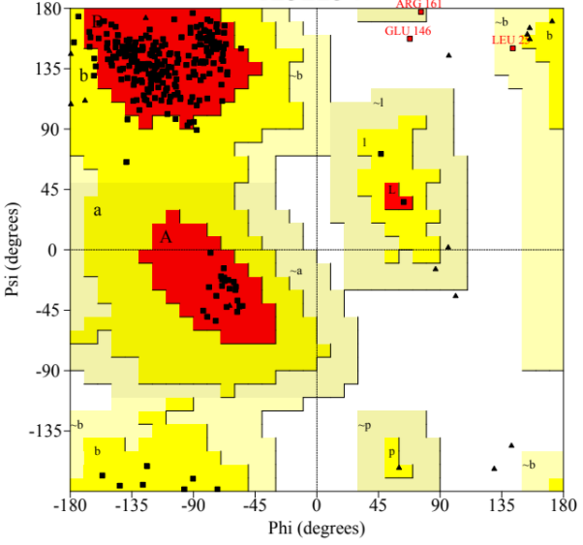
Swiss Model
Modeller
Sus scrofa
(Pig)
Residues in most favoured regions : 96.9%
Residues in most favoured regions : 91%

Slide 17
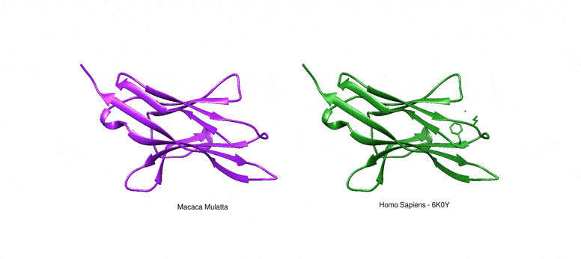
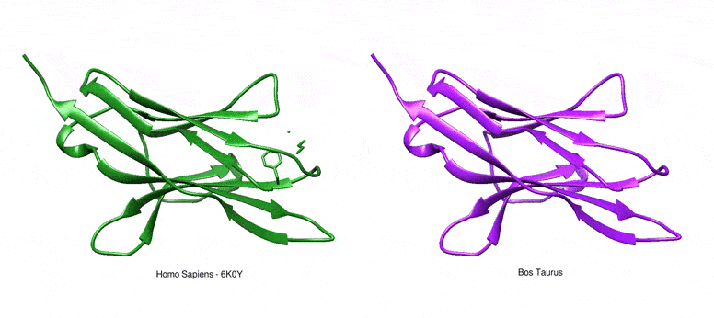
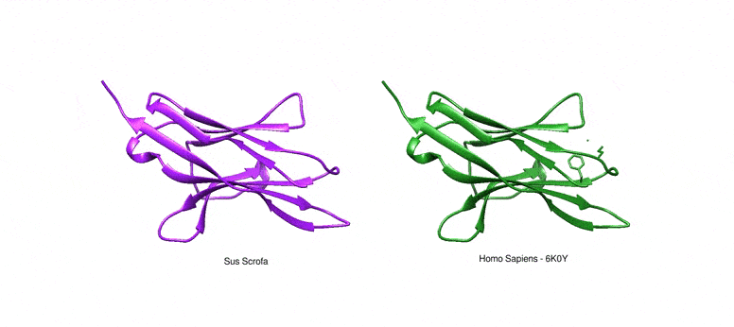
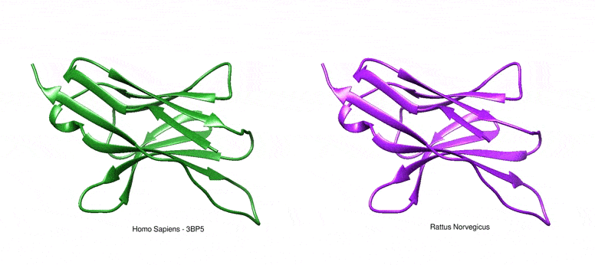
RMSD : 0.073 °A
RMSD : 0.140 °A
RMSD : 0.142 °A
RMSD : 0.088 °A

Slide 18
CONCLUSION
Hypothesis : Sequence analysis = Structure analysis
Observations :
Phylogenetic analysis : Macaca mulatta is closest to Homo sapiens
Homology Modeling : In terms of the RMSD, Macaca mulatta gives us the minimum score.
Interpretation :
Since, sequence and structural analysis give us the same results, we do not reject our
hypothesis. Therefore, we conclude that Macaca mulatta will be the best of the four models
for drug trials and studies related to PD1 protein of Homo sapiens.

Slide 19
Thank You!

